Slide 1
This slide is hidden.
Insert the starting slides after this slide

Slide 2

Welcome to St Michael’s
16th Sunday in Ordinary Time
Year A
You have entered a
SACRED SPACE
– a SACRED TIME...
Please ensure all
mobile phones
are switched off.
Please be respectfully quiet
as we prepare for our celebration.
Notes:
Saturday 5.30PM First Sunday of Advent
MASTER 14th Sunday in Ord Time
MASTER 14th Sunday in Ord Time

Slide 3
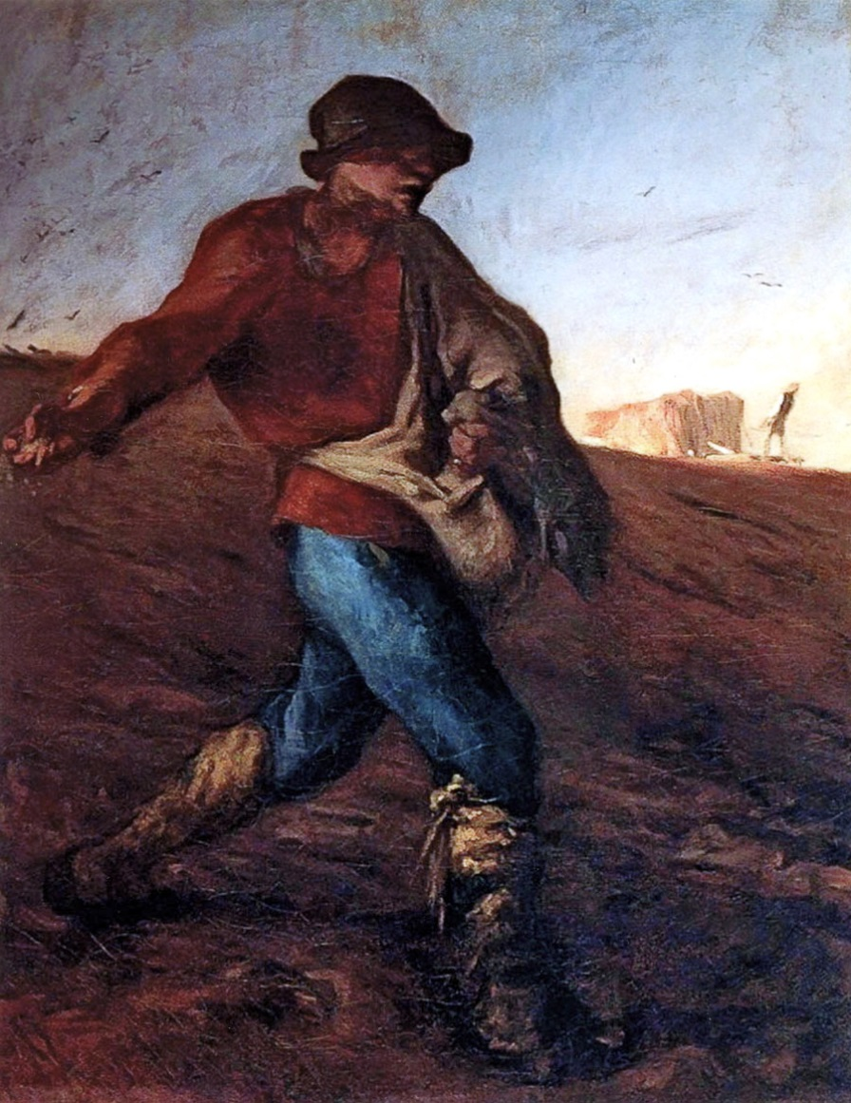
Jesus put a parable before the crowds, 'The kingdom of heaven may be compared to a man who sowed good seed in his field.
Notes:
7am - 14th Sunday in Ord Time
7am - 14th Sunday in Ord Time

Slide 4
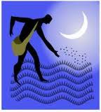
At night, his enemy came, sowed darnel all among the wheat and took off.
Notes:
7am - 14th Sunday in Ord Time
7am - 14th Sunday in Ord Time

Slide 5
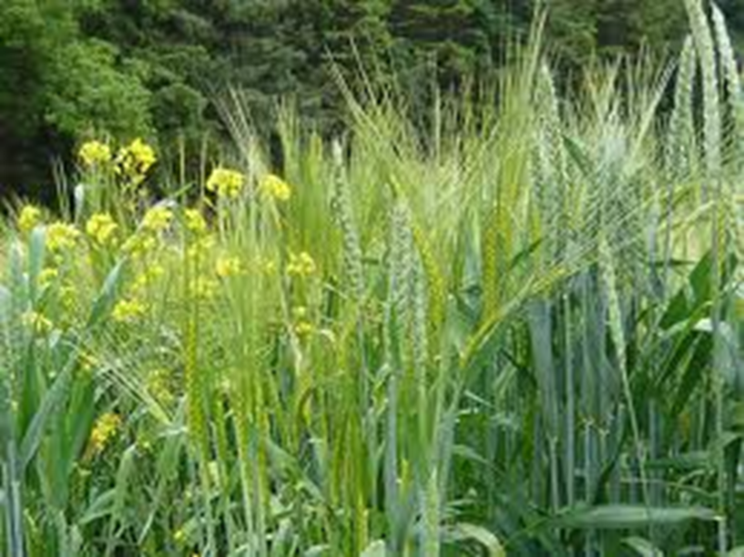
When the new wheat sprouted and ripened, the darnel appeared as well.
And the servants said, "Do you want us to go and weed it out?"
Notes:
7am - 14th Sunday in Ord Time
7am - 14th Sunday in Ord Time

Slide 6
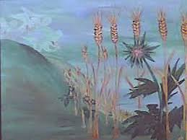
But he said, "No, because when you weed out the darnel you might pull up the wheat with it.”

Slide 7
Please Stand

Slide 8
This slide is hidden.
Insert the Entrance Hymn after this slide

Slide 9
Praise the name of Jesus
Praise the name of Jesus
Praise him as we pray
Praise the name of Jesus
Sing to him all our days

Slide 10
From the rising of the sun
To the setting of the same
The name of the Lord is to be praised
In all things let's praise his name

Slide 11
Praise the name of Jesus
Praise him as we pray
Praise the name of Jesus
Sing ot him all our days

Slide 12
Let us come unto the Lord
Let us make a joyful noise
He has healed us through his word
In all things let's praise his name

Slide 13
Praise the name of Jesus
Praise him as we pray
Praise the name of Jesus
Sing to him all our days
Sing to him all our days

Slide 15
Confiteor
I confess to almighty God
And to you, my brothers and sisters,
That I have greatly sinned
In my thoughts and in my words

Slide 16
In what I have done
And in what I have failed to do,
Through my fault,
Through my fault,
Through my most grievous fault;

Slide 17
Therefore I ask blessed Mary ever-Virgin,
All the Angels and Saints,
And you, my brothers and sisters,
To pray for me to the Lord our God.

Slide 19
Kyrie eleison
Kyrie eleison (2)
Christe eleison (2)
Kyrie eleison (2)

Slide 21
Gloria
Glory to God in the highest,
and on earth peace to people of good will.
We praise you, we bless you,
we adore you, we glorify you,

Slide 22
We give you thanks for your great glory,
Lord, God heavenly king,
O God, almighty father

Slide 23
Glory to God in the highest,
and on earth peace to people of good will.

Slide 24
Lord Jesus Christ, Only Begotten Son,
Lord God, Lamb of God, Son of the Father,
you take away the sins of the world,
have mercy on us;

Slide 25
you take away the sins of the world, receive our prayer;
you are seated at the right hand of the Father,
have mercy on us.

Slide 26
Glory to God in the highest,
and on earth peace to people of good will.

Slide 27
For you alone are the Holy One,
you alone are the Lord,
you alone are the Most High, Jesus Christ,
with the Holy Spirit,
in the glory of God the Father.

Slide 28
Glory to God in the highest,
and on earth peace to people of good will.
Amen.

Slide 30
Responsorial Psalm
Lord you are good and forgiving.

Slide 32
Alleluia
Alleluia, alleluia,
alleluia, alleluia

Slide 34
Apostles Creed
I believe in God,
the Father almighty,
Creator of heaven and earth,
and in Jesus Christ, his only Son, our Lord,
(At the words that follow, up to and including the Virgin Mary, all bow.)

Slide 35
who was conceived by the Holy Spirit,
born of the Virgin Mary,
suffered under Pontius Pilate,
was crucified, died and was buried;
he descended into hell;

Slide 36
on the third day he rose again from the dead;
he ascended into heaven,
and is seated at the right hand of God the Father almighty;

Slide 37
from there he will come to judge the living and the dead.
I believe in the Holy Spirit,
the holy catholic Church,

Slide 38
the communion of saints,
the forgiveness of sins,
the resurrection of the body,
and life everlasting.
Amen.

Slide 40
First Collection
This collection goes to the Bishop
for the support of the Diocese.
Thank you for your contribution

Slide 42
This slide is hidden.
Insert the Offertory Hymn after this slide.

Slide 43

Lord, I offer my life
All that I am, all that I have
I lay them down before you, oh Lord
All my regrets, all my acclaims
The joy and the pain,
I'm making them yours

Slide 44
Lord, I offer my life to you
Everything I've been through
Use it for your glory

Slide 45
Lord I offer my days to you
Lifting my praise to you
As a pleasing sacrifice
Lord I offer you my life

Slide 46
Things in the past, things yet unseen
Wishes and dreams
that are yet to come true
All of my hopes, all of my plans
My heart and my hands are lifted to you

Slide 47
Lord, I offer my life to you
Everything I've been through
Use it for your glory

Slide 48
Lord I offer my days to you
Lifting my praise to you
As a pleasing sacrifice
Lord I offer you my life

Slide 49
What can we give that you have not given?
And what do we have
That is not already yours?
All we possess are these lives we're living
That's what we give to you, Lord

Slide 50
Lord, I offer my life to you
Everything I've been through
Use it for your glory

Slide 51
Lord I offer my days to you
Lifting my praise to you
As a pleasing sacrifice
Lord I offer you my life

Slide 53
Priest: Pray my brothers and sisters,
that my sacrifice and yours may be
acceptable to God, the almighty Father.
All: May the Lord accept the sacrifice
at your hands for the praise and glory of his name, for our good and the good of all his holy Church.

Slide 54
Priest: The Lord be with you.
All: And with your spirit.
Priest: Lift up your hearts.
All: We lift them up to the Lord.

Slide 55
Priest: Let us give thanks to the
Lord our God.
All: It is right and just.

Slide 57
Holy
Holy, Holy, Holy Lord God of hosts,
Heaven and earth are full of your glory. Hosanna in the highest
Blessed is he who comes
in the name of Lord,
Hosanna in the highest.

Slide 59
Memorial acclamation
Save us saviour of the world,
For by your cross and resurrection,
You have set us free

Slide 60
Memorial acclamation
When we eat this bread
And drink this cup
We proclaim your death O Lord
Until you come again

Slide 61
Memorial acclamation
We proclaim your death O Lord
And profess your resurrection
Until you come again

Slide 63
Amen
Amen, amen, amen, amen.
Amen, amen, amen, amen.

Slide 65
Priest: The Lord be with you.
All: And with your spirit

Slide 67
Peace
May the peace of the Lord be with you
With your friends and your family too
Let it be, let it grow
And everywhere you go
May the peace of the Lord follow you

Slide 68
Lamb of God
Lamb of God, lamb of God
You take away the sins of the world
Have mercy on us, lamb of God

Slide 69
Lamb of God, lamb of God
You take away the sins of the world
Have mercy on us, lamb of God

Slide 70
Lamb of God, lamb of God
You take away the sins of the world
Grant us, grant us peace

Slide 72
Priest: Behold the Lamb of God, behold him
who takes away the sins of the world.
Blessed are those called to the supper of the Lamb.
All: Lord, I am not worthy
that you should enter under my roof,
but only say the word
and my soul shall be healed.

Slide 73
This slide is hidden.
Insert the Communion Hymns after this slide.

Slide 74
In love for me
This is my body broken for you
Bringing you wholeness making you free
Take it and eat it, and when you do
Do it in love for me

Slide 75
This is my blood poured out for you
Bringing forgiveness, making you free
Take it and drink it, and when you do
Do it in love for me

Slide 76
This is my body broken for you
Bringing you wholeness making you free
Take it and eat it, and when you do
Do it in love for me

Slide 77
This is my blood poured out for you
Bringing forgiveness, making you free
Take it and drink it, and when you do
Do it in love for me
Do it in love for me

Slide 78
I am the bread of life
I am the bread of life,
He who comes to me shall not hunger,
He who believes in me shall not thirst.
No one can come to me
Unless the Father draw him.

Slide 79
And I will raise him up,
And I will raise him up,
And I will raise him up on the last day.

Slide 80
The bread that I will give
Is my flesh for the life of the world,
And he who eats of this bread,
He shall live for ever,
He shall live for ever.

Slide 81
And I will raise him up,
And I will raise him up,
And I will raise him up on the last day.

Slide 82
Unless you eat of the flesh
Of the Son of Man,
And drink of His blood
And drink of His blood,
You shall not have life within you

Slide 83
And I will raise him up,
And I will raise him up,
And I will raise him up on the last day.

Slide 84
And I will raise him up,
And I will raise him up,
And I will raise him up on the last day.

Slide 85
But I wish you Jesus
I could wish you joy and peace
To last your whole life long
I could wish you sunshine
Or a cheerful little song

Slide 86
Or wish you all the happiness
That this life could bring

Slide 87
But I wish you Jesus
But I wish you Jesus
But I wish you Jesus
More than anything

Slide 88
I could wish you leaves of gold
And may your path be smooth,
I could wish you treasures
Or that all your dreams come true

Slide 89
And I could wish you paradise
that every day be spring,

Slide 90
But I wish you Jesus
But I wish you Jesus
But I wish you Jesus
More than anything

Slide 91
'Cos when I've wished you Jesus
I've wished you everything

Slide 93
Second Collection
What you contribute now
is for the support of our
parish and its mission.
Thank you for your generosity

Slide 94
This slide is hidden.
Insert the Notices for the week after this slide

Slide 95
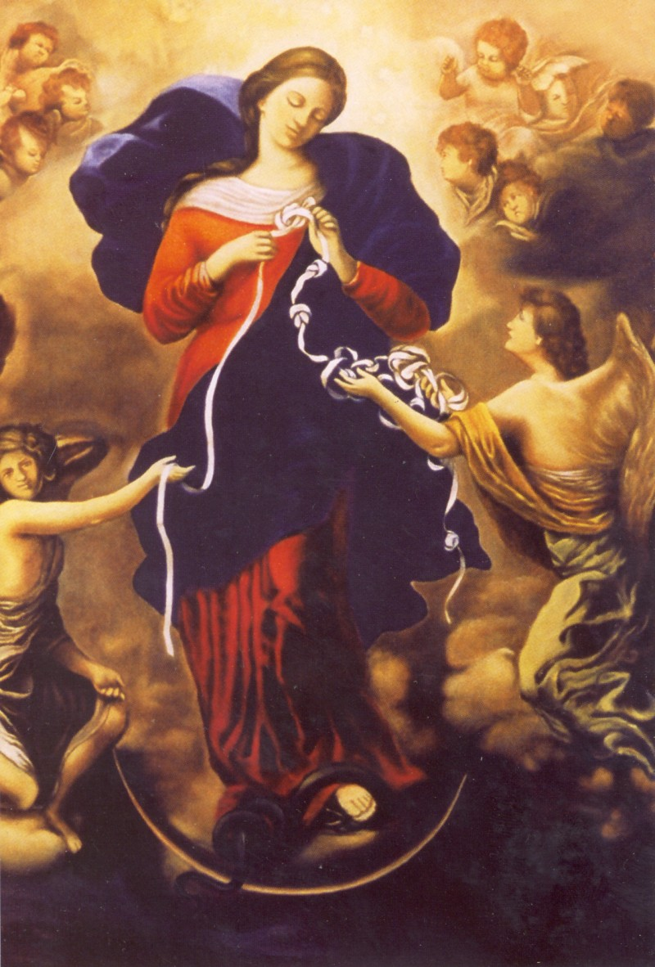
MARY, UNTIER OF KNOTS PRAYER GROUP
TUESDAYS 2.00PM
St Michael’s Parish Centre
All Welcome!
Bring your Rosary Beads

Slide 96

GRANDPARENTS:GREAT PRESENCE
Please pick up your free leaflet from the Australian Catholic Marriage and Family Office from the church entrances.

Slide 97

IFM #LIFE_FAITH INTITIATIVE
IFM Blacktown
7.30pm – 9.30pm
Thursday 7 August
Thursday 4 September
Monday 20 October

Slide 98

SVDP PANTRY
Sugar;
Pasta Sauce;
Spreads (Jam/Honey/Vegemite);
Tinned Meat (corned beef, leg ham)
Thank you for your
generous support!

Slide 99
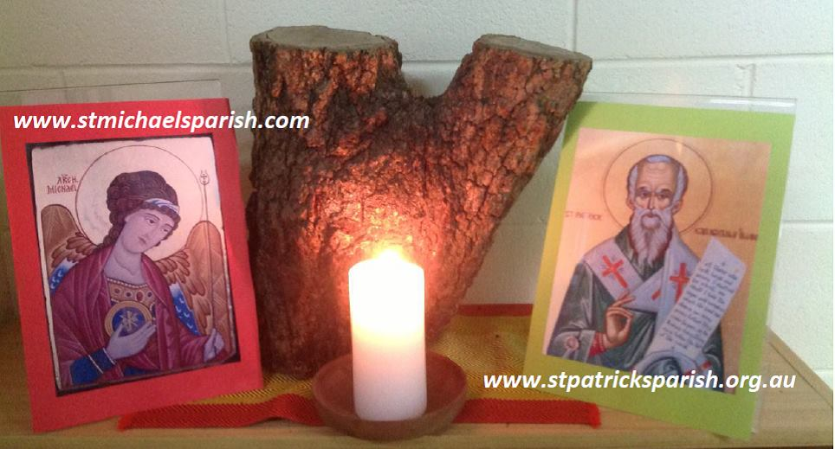
Please take home your bulletin or download it
www.stmichaelsparish.com
Visit us on Facebook
www.facebook.com/blacktowncatholics

Slide 100
This slide is hidden.
The next slide can be used for videos.
Insert the video into the slide.

Slide 102
Priest: The Lord be with you.
All: And with your spirit.

Slide 104
This slide is hidden.
Insert the Recessional Hymns after this slide.

Slide 105
I have decided
I have decided to follow Jesus
I have decided to follow Jesus
I have decided to follow Jesus
No turning back
No turning back

Slide 106
The world behind me, the cross before me
The world behind me, the cross before me
The world behind me, the cross before me
No turning back
No turning back

Slide 107
Though none go with me, still I will follow
Though none go with me, still I will follow
Though none go with me, still I will follow
No turning back
No turning back

Slide 108
This slide is hidden.
Insert the final slide here.

